Slide 1
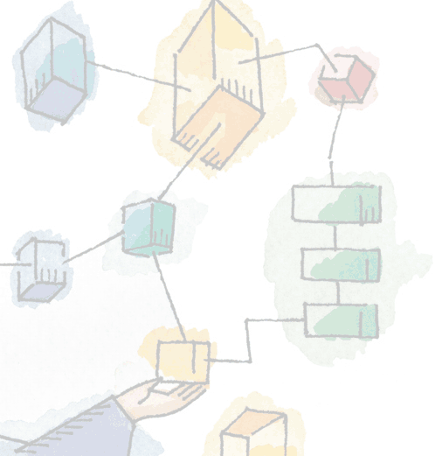
Chapter 1 Computer System Overview
Operating Systems: Internals and Design Principles, 6/E William Stallings

Slide 2
Operating System
Exploits the hardware resources of one or more processors
Provides a set of services to system users
Manages secondary memory and I/O devices

Slide 3
Basic Elements
Processor
Two internal registers
Memory address resister (MAR)
Specifies the address for the next read or write
Memory buffer register (MBR)
Contains data written into memory or receives data read from memory

Slide 4
Basic Elements
Processor
I/O address register
I/O buffer register

Slide 5
Basic Elements
Main Memory
Volatile
Referred to as real memory or primary memory

Slide 6
Basic Elements
I/O Modules
Secondary Memory Devices
Communications equipment
Terminals
System bus
Communication among processors, main memory, and I/O modules

Slide 7
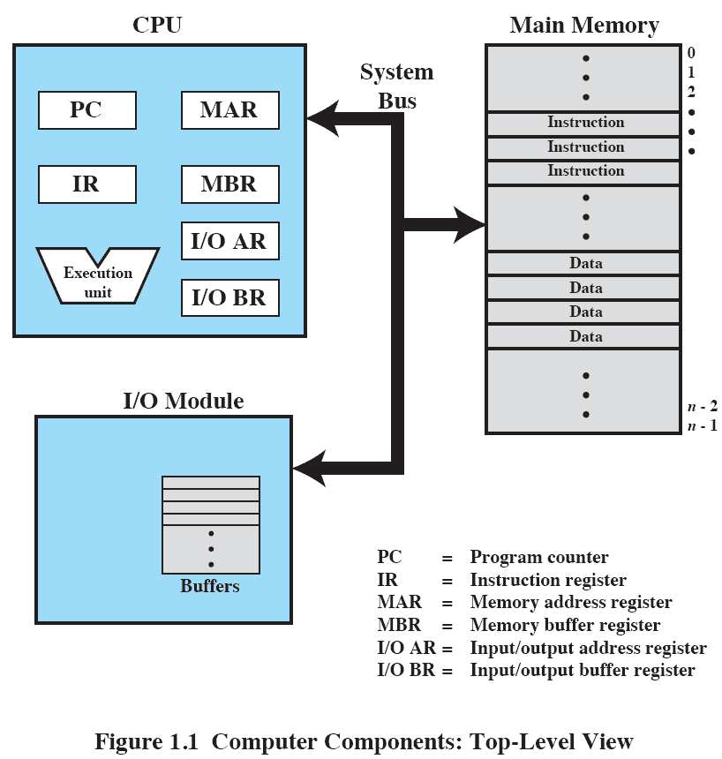
Computer Components: Top-Level View

Slide 8
Processor Registers
User-visible registers
Enable programmer to minimize main memory references by optimizing register use
Control and status registers
Used by processor to control operating of the processor
Used by privileged OS routines to control the execution of programs
Notes:
e.g. comparisons. It usually consists of several independent flags such as carry, overflow and zero.

Slide 9
User-Visible Registers
May be referenced by machine language
Available to all programs – application programs and system programs

Slide 10
User-Visible Registers
Data
Address
Index register: Adding an index to a base value to get the effective address
Segment pointer: When memory is divided into segments, memory is referenced by a segment and an offset
Stack pointer: Points to top of stack
Notes:
Pointer Registers
Instruction Pointer (IP) − The 16-bit IP register stores the offset address of the next instruction to be executed. IP in association with the CS register (as CS:IP) gives the complete address of the current instruction in the code segment.
Stack Pointer (SP) − The 16-bit SP register provides the offset value within the program stack. SP in association with the SS register (SS:SP) refers to be current position of data or address within the program stack.
Base Pointer (BP) − The 16-bit BP register mainly helps in referencing the parameter variables passed to a subroutine. The address in SS register is combined with the offset in BP to get the location of the parameter. BP can also be combined with DI and SI as base register for special addressing.
Index Registers
Source Index (SI) − It is used as source index for string operations.
Destination Index (DI) − It is used as destination index for string operations.

Slide 11
Control and Status Registers
Program counter (PC)
Contains the address of an instruction to be fetched
Instruction register (IR)
Contains the instruction most recently fetched
Program status word (PSW)
Contains status information
Notes:
program status word (PSW) is a register that performs the function of a status register and program counter, and sometimes more

Slide 12
Control and Status Registers
Condition codes or flags
Bits set by processor hardware as a result of operations
Example
Positive, negative, zero, or overflow result

Slide 13
Instruction Execution
Two steps
Processor reads (fetches) instructions from memory
Processor executes each instruction

Slide 14
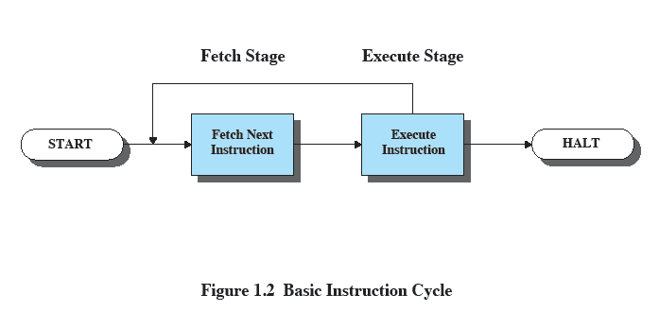
Basic Instruction Cycle

Slide 15
Instruction Fetch and Execute
The processor fetches the instruction from memory
Program counter (PC) holds address of the instruction to be fetched next
PC is incremented after each fetch

Slide 16
Instruction Register
Fetched instruction loaded into instruction register
Categories
Processor-memory, processor-I/O, data processing, control
Notes:
Categories of instruction registers.

Slide 17
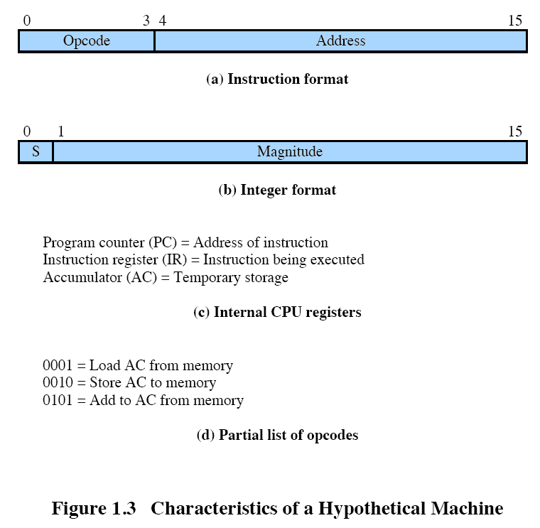
Characteristics of a Hypothetical Machine
Notes:
Mesin yang menterjemahkan kode instruksi dengan simplifikasi bentuk kode

Slide 18
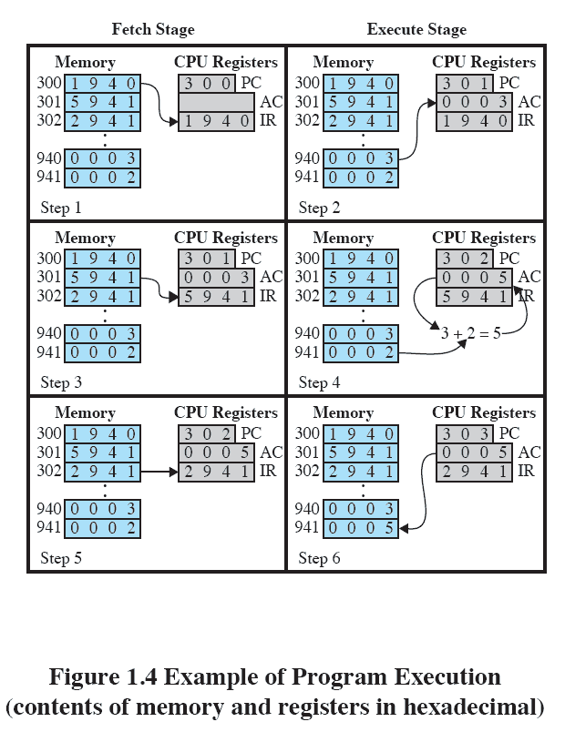
Example of Program Execution

Slide 19
Interrupts
Interrupt the normal sequencing of the processor
Most I/O devices are slower than the processor
Processor must pause to wait for device

Slide 20
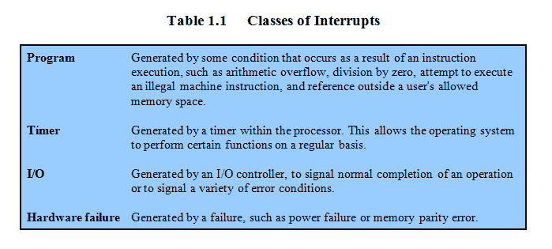
Classes of Interrupts

Slide 21
Interrupt Stage
Processor checks for interrupts
If interrupt
Suspend execution of program
Execute interrupt-handler routine

Slide 22
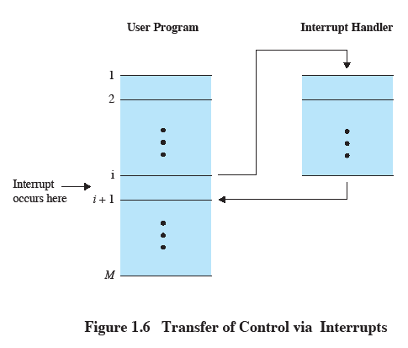
Transfer of Control via Interrupts

Slide 23
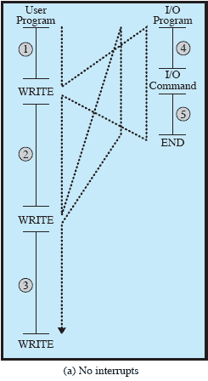
Program Flow of Control

Slide 24
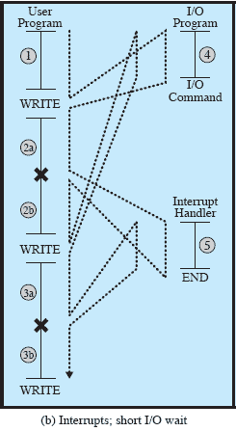
Program Flow of Control

Slide 25
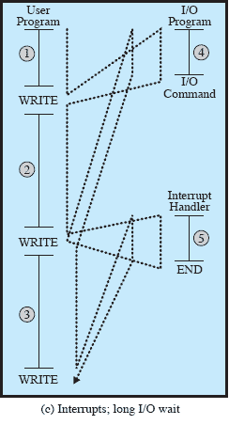
Program Flow of Control

Slide 26
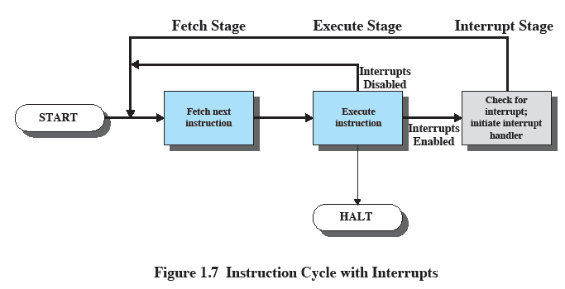
Instruction Cycle with Interrupts

Slide 27
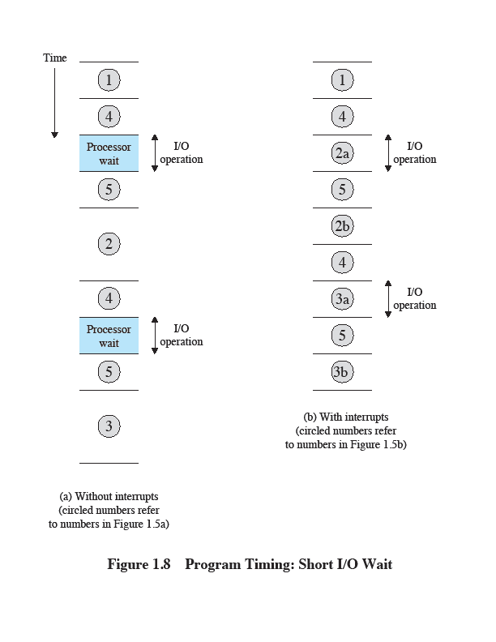
Program Timing: Short I/O Wait

Slide 28
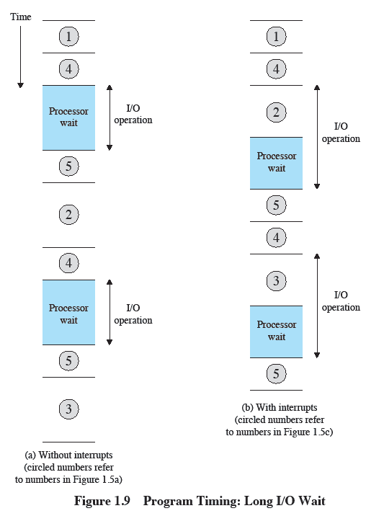
Program Timing: Long I/O Wait

Slide 29
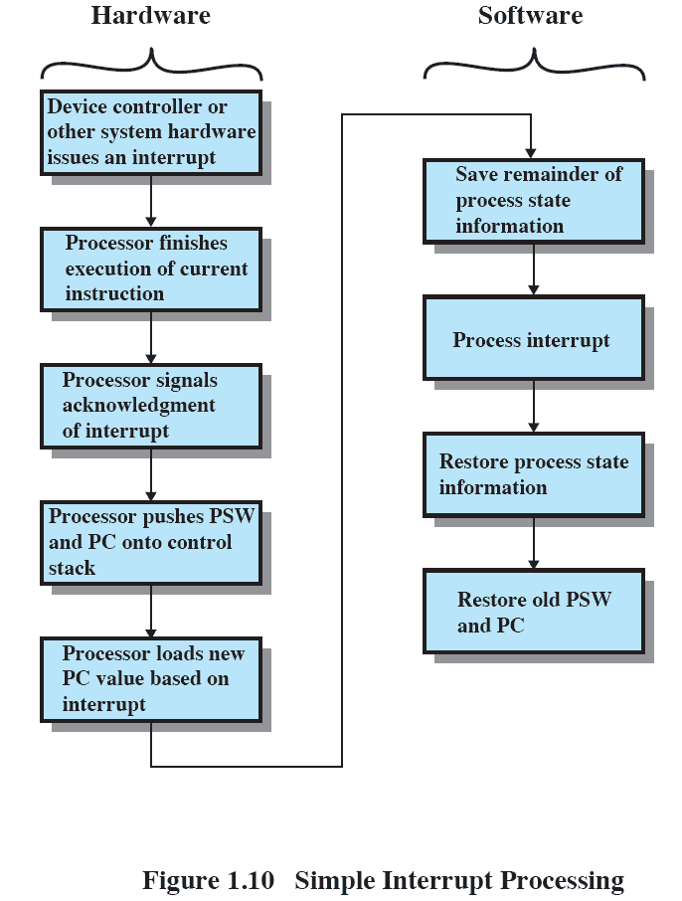
Simple Interrupt Processing

Slide 30
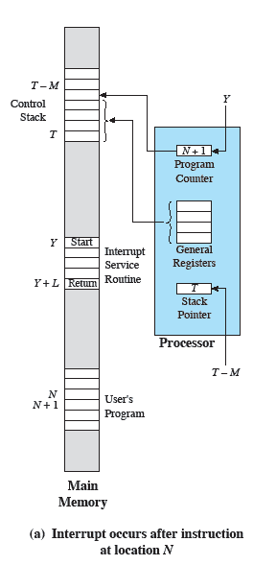
Changes in Memory and Registers for an Interrupt

Slide 31
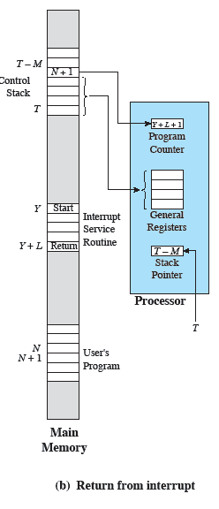
Changes in Memory and Registers for an Interrupt

Slide 32
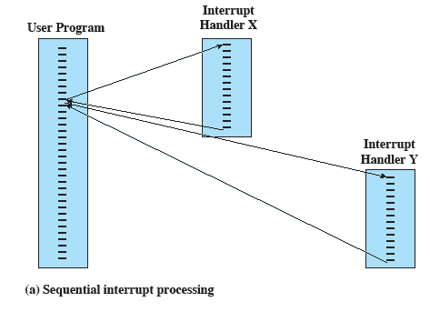
Sequential Interrupt Processing

Slide 33
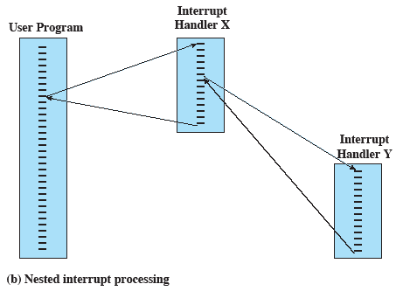
Nested Interrupt Processing

Slide 34
Multiprogramming
Processor has more than one program to execute
The sequence in which programs are executed depend on their relative priority and whether they are waiting for I/O
After an interrupt handler completes, control may not return to the program that was executing at the time of the interrupt

Slide 35
Memory Hierarchy
Faster access time, greater cost per bit
Greater capacity, smaller cost per bit
Greater capacity, slower access speed

Slide 36
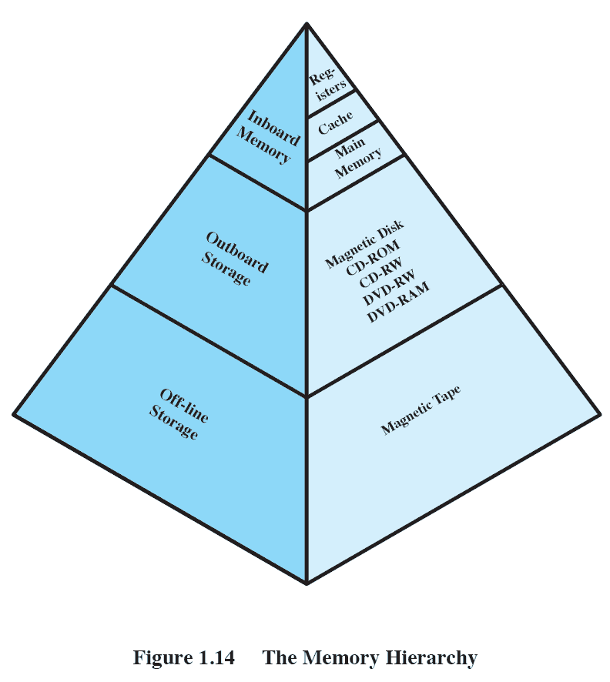
The Memory Hierarchy

Slide 37
Going Down the Hierarchy
Decreasing cost per bit
Increasing capacity
Increasing access time
Decreasing frequency of access to the memory by the processor

Slide 38
Secondary Memory
Auxiliary memory
External
Nonvolatile
Used to store program and data files

Slide 39
Cache Memory
Processor speed faster than memory access speed
Exploit the principle of locality with a small fast memory

Slide 40
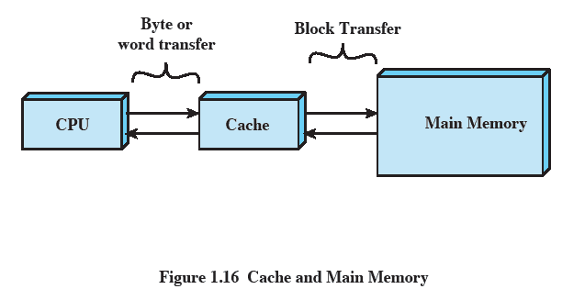
Cache and Main Memory

Slide 41
Cache Principles
Contains copy of a portion of main memory
Processor first checks cache
If desired data item not found, relevant block of memory read into cache
Because of locality of reference, it is likely that future memory references are in that block

Slide 42
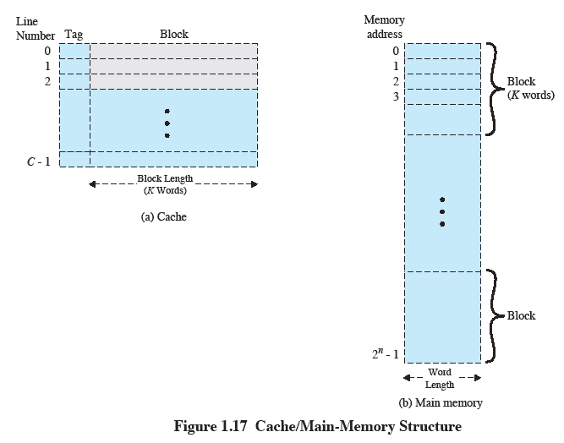
Cache/Main-Memory Structure

Slide 43
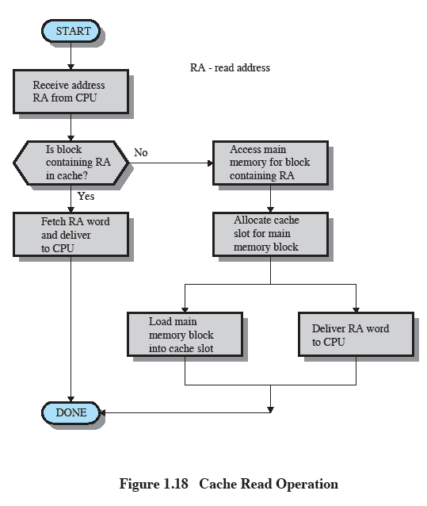
Cache Read Operation

Slide 44
Cache Principles
Cache size
Even small caches have significant impact on performance
Block size
The unit of data exchanged between cache and main memory
Larger block size yields more hits until probability of using newly fetched data becomes less than the probability of reusing data that have to be moved out of cache

Slide 45
Cache Principles
Mapping function
Determines which cache location the block will occupy
Replacement algorithm
Chooses which block to replace
Least-recently-used (LRU) algorithm

Slide 46
Cache Principles
Write policy
Dictates when the memory write operation takes place
Can occur every time the block is updated
Can occur when the block is replaced
Minimize write operations
Leave main memory which are in an obsolete state

Slide 47
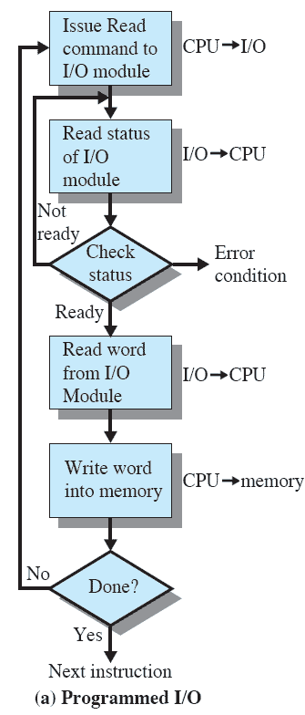
Programmed I/O
I/O module performs the action, not the processor
Sets the appropriate bits in the I/O status register
No interrupts occur
Processor checks status until operation is complete

Slide 48
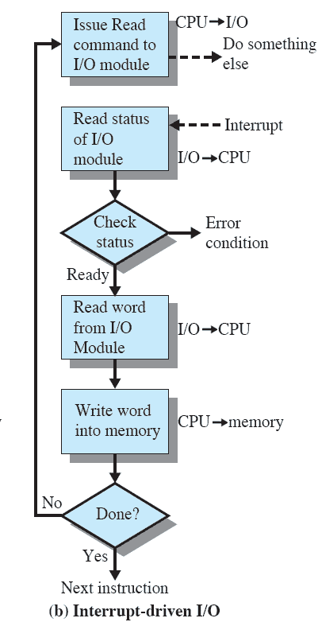
Interrupt-Driven I/O
Processor is interrupted when I/O module ready to exchange data
Processor saves context of program executing and begins executing interrupt-handler

Slide 49
Interrupt-Driven I/O
No needless waiting
Consumes a lot of processor time because every word read or written passes through the processor

Slide 50
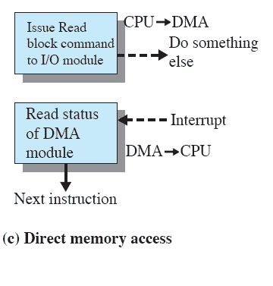
Direct Memory Access
Transfers a block of data directly to or from memory
An interrupt is sent when the transfer is complete
More efficient

